Slide 1
The Technology Behind smart Meters

Slide 2
The Smart Grid is…
The systematic modernization of a very old electric power transmission system
A change from entirely producer-controlled to a more system responsive and customer-driven model

Slide 3
Click to watch PBS Nova video overview of Smart Grid technology

Slide 4
Click to watch an animation of Smart Grid “self-healing” technology during power outages

Slide 5
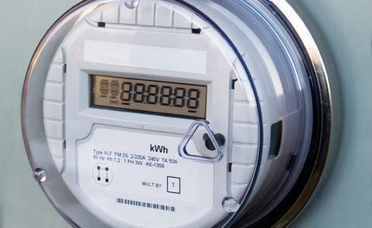
The Smart Meter is…
Just one component of a smarter grid system
A meter that monitors power usage and reports it to the utility company and/or the consumer
A meter that better detects system malfunctions for rapid response

Slide 6
Benefits of a Smart Meter
Better access to data to manage energy consumption
More accurate and timely billing
Improved rate/pricing options
Improved detection of meter tampering/theft
Reduced estimated billing errors
Improved data for efficient grid operation
Edison Electric Institute, 2011

Slide 7
Benefits of a Smart Meter
Can record the amount of energy a consumer feeds back into the grid through co-generation (or distributed generation) of electricity through solar panels or wind turbines
They may require fewer trips by a meter reader to your site
Smartmeters.com

Slide 8
How does it work?
Automatic Meter Reading (AMR) technology transmits data from the meter to the utility company (one-way communication) using telemetry
Advanced Metering Infrastructure (AMI) uses enhanced two-way communication to send data back and forth between the meter (and associated customer) and the utility company

Slide 9
Growth of AMR and AMI Use

Slide 10
Interface with Smart Appliances
A Smart Meter system can “talk” to smart appliances such as a customer’s home thermostat or dishwasher that consume a lot of electricity
It can relay messages (via the Advanced Metering Infrastructure) from the utility company to the appliance
This two-way conversation can result in the automatic adjustment of the appliance’s setting and electricity use
This system, when applied over a large grid system, can prevent outages at peak usage times

Slide 11
Sending the data
There are multiple means of sending data using technologies we use every day
Cell phone /pager networks
Satellite
Licensed or unlicensed radio frequencies
Wireless
The Smart Grid: An Introduction, U.S. DOE

Slide 12
Click to watch CenterPoint Energy video “How to Build an Advanced Metering System”

Slide 13
For More Information
How Smart Homes Work http://tlc.howstuffworks.com/home/smart-home.htm
GE Smart Meter Technology http://ge.ecomagination.com/smartgrid/#/smart_meters
PGE See Your Power http://www.pge.com/smartmeter/

